Slide 1
CS773-2025-Spring: Computer Architecture for Performance and Security
Lecture 14: DRAM attacks

Slide 2
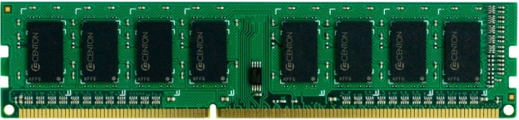
DRAM Organization
Channel
Rank 1 with 8 chips
DIMM
Rank
Rank 0 with 8 chips
Chip
Bank
Row
Column

Slide 3
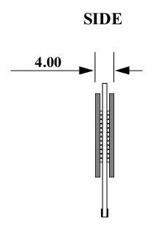
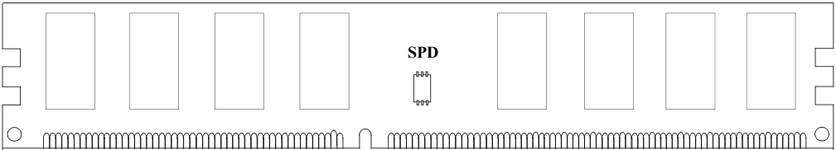
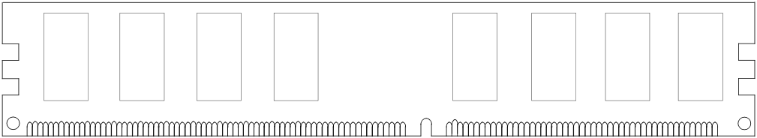
Rank
DIMM (Dual in-line memory module)
Side view
Front of DIMM
Back of DIMM
Rank 0: collection of 8 chips
Rank 1

Slide 4
Ranks, Banks, Rows, Columns
Rank 0
Rank 1
Bank 0
Bank 1
DIMM
Bank 2
Bank 3
Multiple Chips

Slide 5
Ranks, Banks, Rows, Columns
Rank 0
Chip
Bank 0
Bank 1
16
64 bits
16
Bank
16
Bank 2
Bank 3
16
Row
X16 device (DRAM width, # output pins)
Column
16-bit interface: 16 bits from each chip in one go

Slide 6
Row Decoder and Row buffer
2KB
Each bank has a row buffer
Row Decoder
Stores the last used row
Row Buffer
Column mux

Slide 7
DRAM Address Mapping (One Channel)
2GB DRAM, 8 Banks, 16K rows, 2K Columns per bank
Cache Interleaving: Consecutive cache blocks in consecutive banks
Row (14 bits)
High Column
Bank (3 bits)
Low Col.
Byte in bus (3 bits)
8 bits
3 bits
Row Interleaving: Consecutive rows in consecutive banks
Row (14 bits)
Bank (3 bits)
Column (11 bits)
Byte in bus (3 bits)

Slide 8
Row Buffer hit/miss/conflict
Access Address:
(Row 0, Column 0)
Columns
(Row 0, Column 1)
(Row 0, Column 85)
(Row 1, Column 0)
Row address 0
Row address 1
Row decoder
Rows
Row Buffer
CONFLICT !
HIT
Row 1
HIT
Row 0
Empty
Column address 0
Column mux
Column address 0
Column address 1
Column address 85
Data
ACTIVATE, PRECHARGE, and Column read are the three commands of interest

Slide 9
Row (Page) Policies
Open Page (do not get confused with an OS page)
After an access: Keep the page in the row-buffer
Consecutive accesses to the same page : Row-buffer Hit (no ACTs)
On an access to different page: Close the row and open the new one
Closed page:
After an access: Close the page if there are no accesses to the same row in the request queue.
Consecutive accesses to different page : Low latency
On an access to different page: No need to close the row (no PREs)

Slide 10
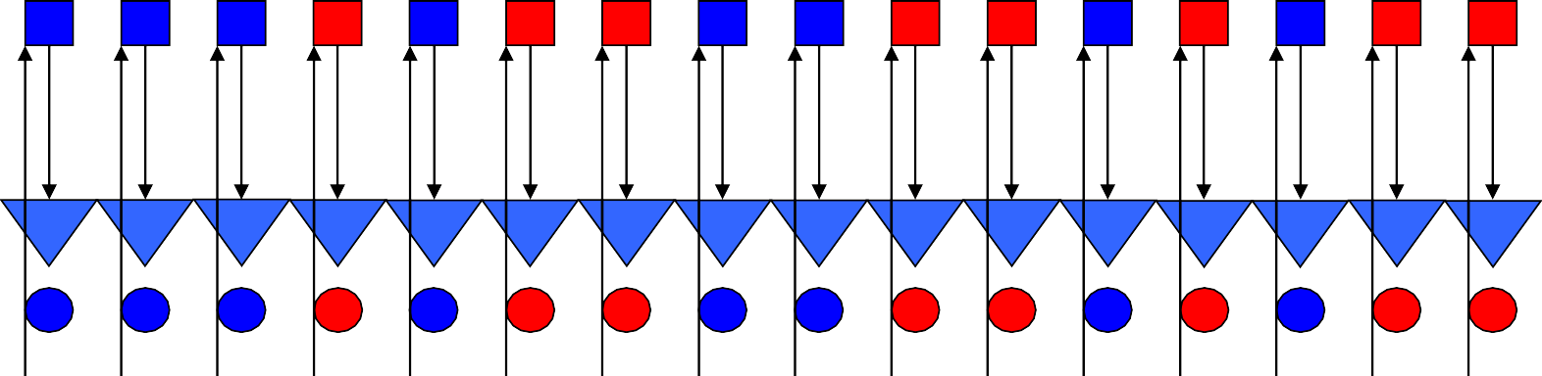
DRAM Refresh
DRAM cells
Row Buffer
DRAM cells lose contents after a while,
Refresh command refreshes all rows at different granularity
How to implement a refresh? What is the latency? How frequent?
DRAM cells are refreshed every 64 ms at normal temperature (< 85◦C).

Slide 11
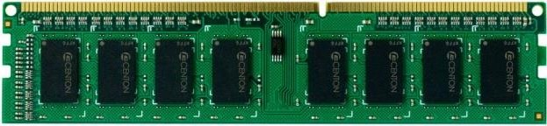
DRAM Controller (On-chip)
LLC
DRAM
Controller
Addr. Mapper
RQ WQ
CQ
CQ
CQ
CQ
Command Scheduler
Command and Address bus
Frequency 800MHz
1066MHz
1333MHz
Double Data Rate (DDR)
Data bus (burst length= eight beats each of 64-bits)
Frequency 1600MHz
2133MHz
2666MHz

Slide 12
DRAM Bandwidth
Names | Memory clock | I/O bus clock | Transfer rate | Theoretical bandwidth
DDR-200, PC-1600 | 100 MHz | 100 MHz | 200 MT/s | 1.6 GB/s
DDR-400, PC-3200 | 200 MHz | 200 MHz | 400 MT/s | 3.2 GB/s
DDR2-800, PC2-6400 | 200 MHz | 400 MHz | 800 MT/s | 6.4 GB/s
DDR3-1600, PC3-12800 | 200 MHz | 800 MHz | 1600 MT/s | 12.8 GB/s
DDR4-2400, PC4-19200 | 300 MHz | 1200 MHz | 2400 MT/s | 19.2 GB/s
DDR4-3200, PC4-25600 | 400 MHz | 1600 MHz | 3200 MT/s | 25.6 GB/s
DDR5-4800, PC5-38400 | 300 MHz | 2400 MHz | 4800 MT/s | 38.4 GB/s
DDR5-6400, PC5-51200 | 400 MHz | 3200 MHz | 6400 MT/s | 51.2 GB/s

Slide 13
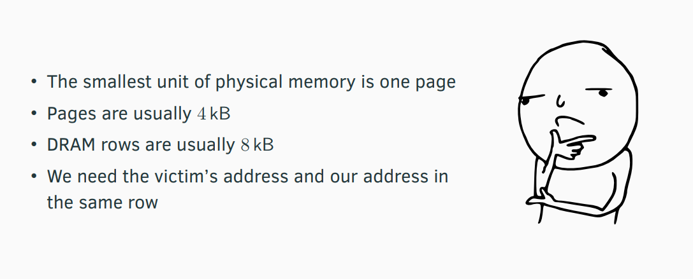
How to attack ?

Slide 14
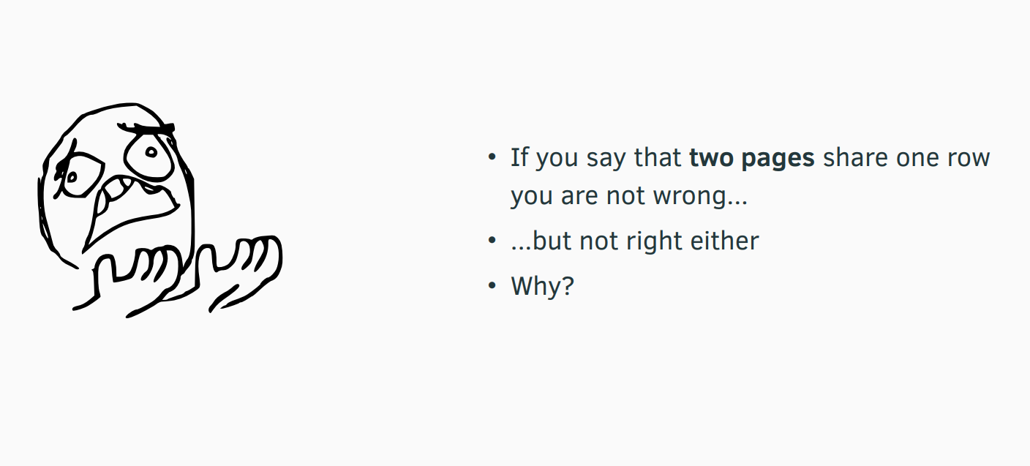
Aha !!

Slide 15
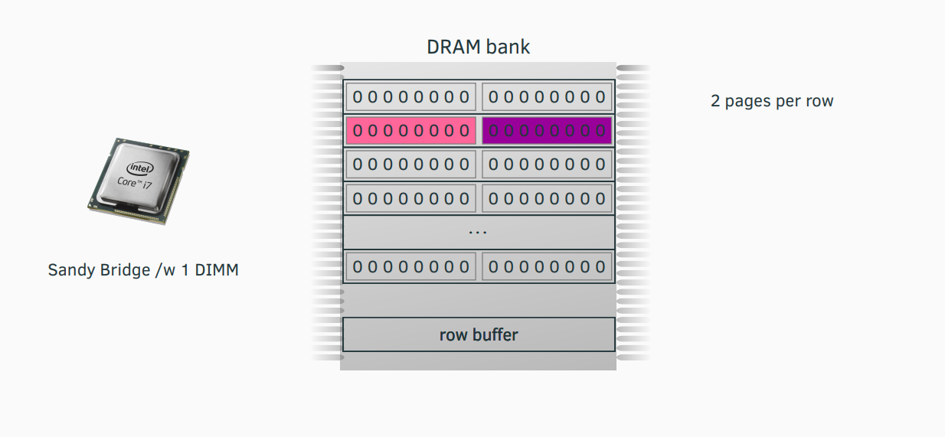
Shared Row [USENIX sec. ‘16]

Slide 16
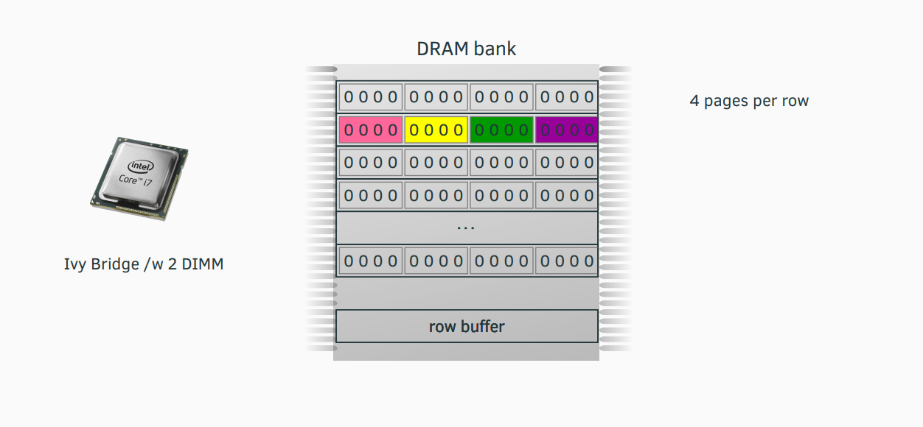
Shared Row [USENIX sec. ‘16]

Slide 17
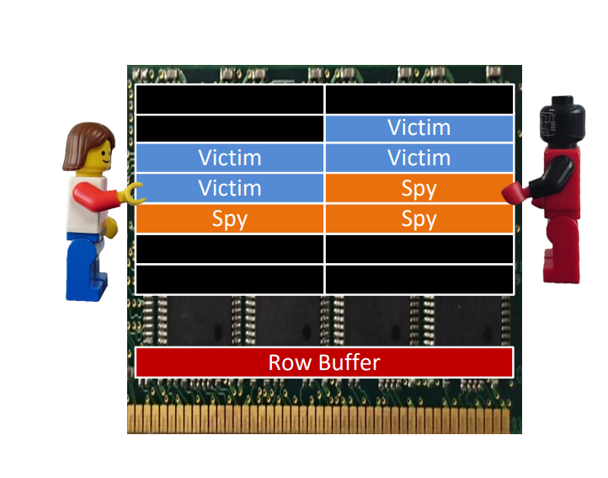
Side Channel
Side-channel attacks
Row-hits: Fast access
Conflicts: Slow access

Slide 18
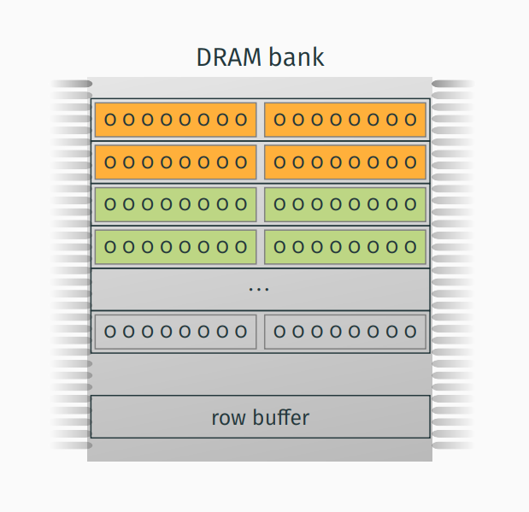
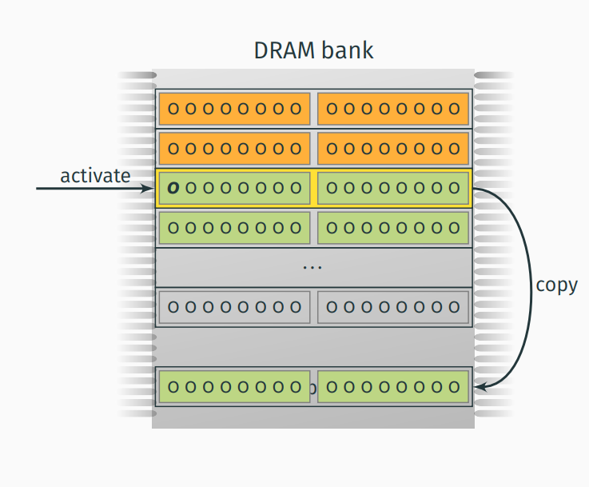
Row-Buffer

Slide 19
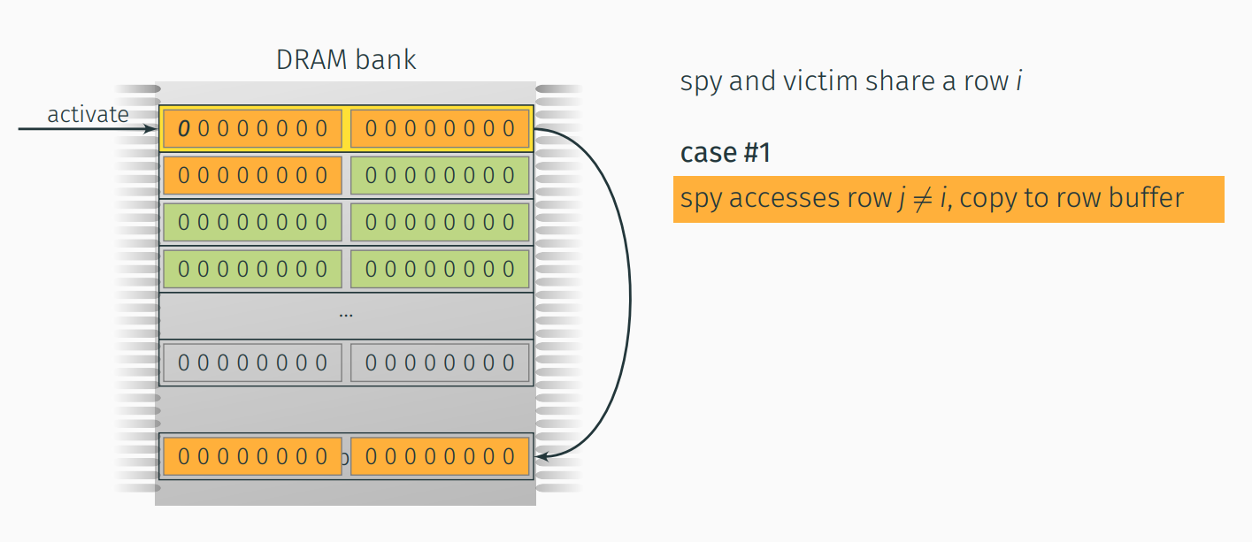
Side-Channel Attack [USENIX sec. ‘16]

Slide 20
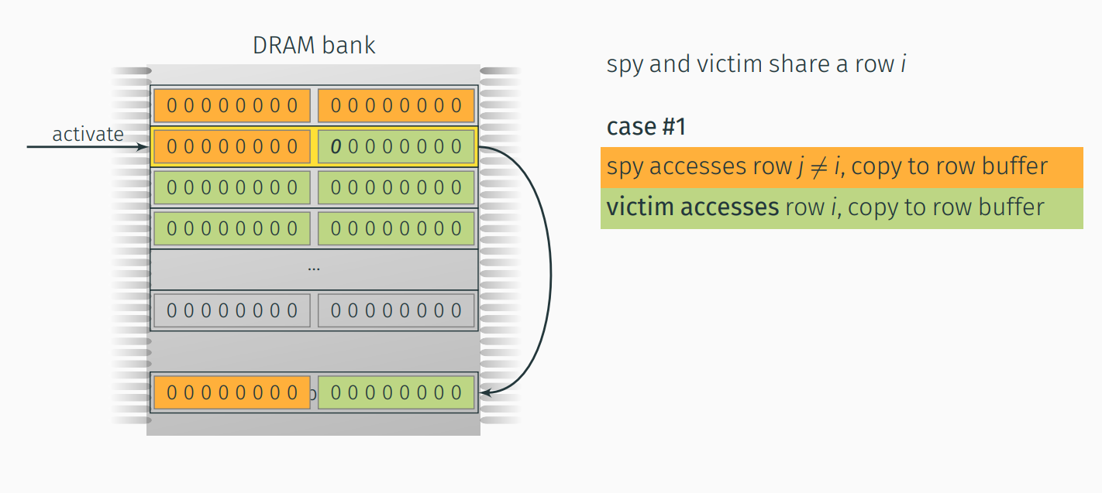
Side-Channel Attack [USENIX sec. ‘16]

Slide 21
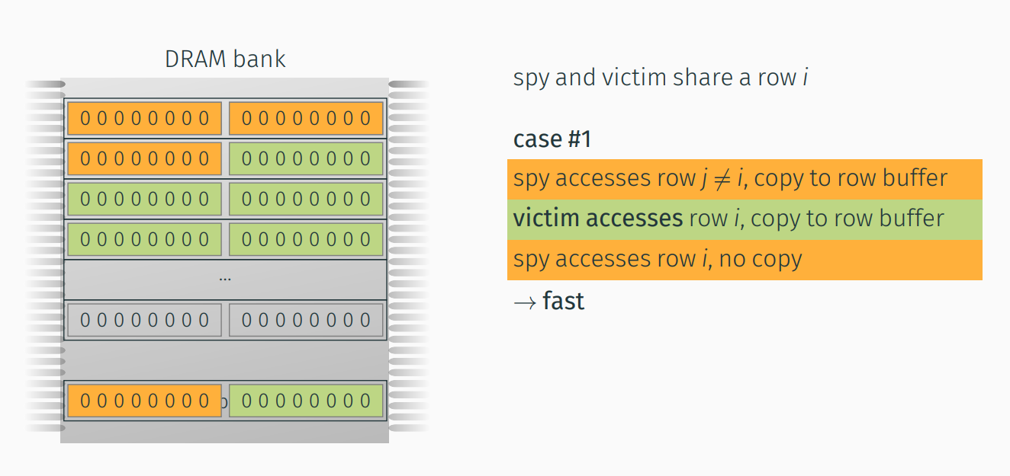
Side-Channel Attack (Remember no actual sharing needed)

Slide 22
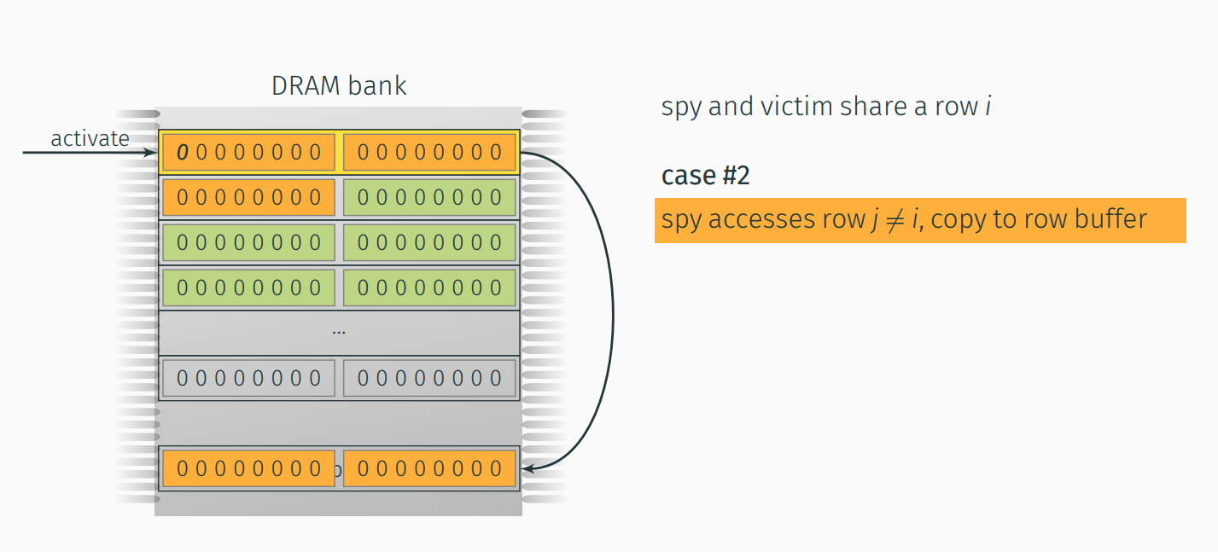
Side-Channel Attack [USENIX sec. ‘16]

Slide 23
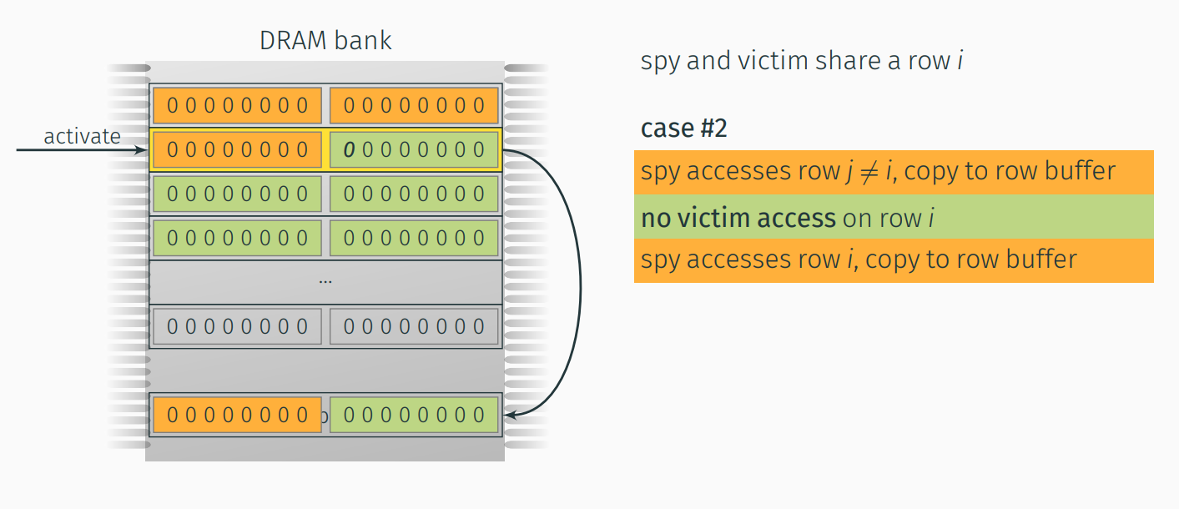
Side-Channel Attack [USENIX sec. ‘16]

Slide 24
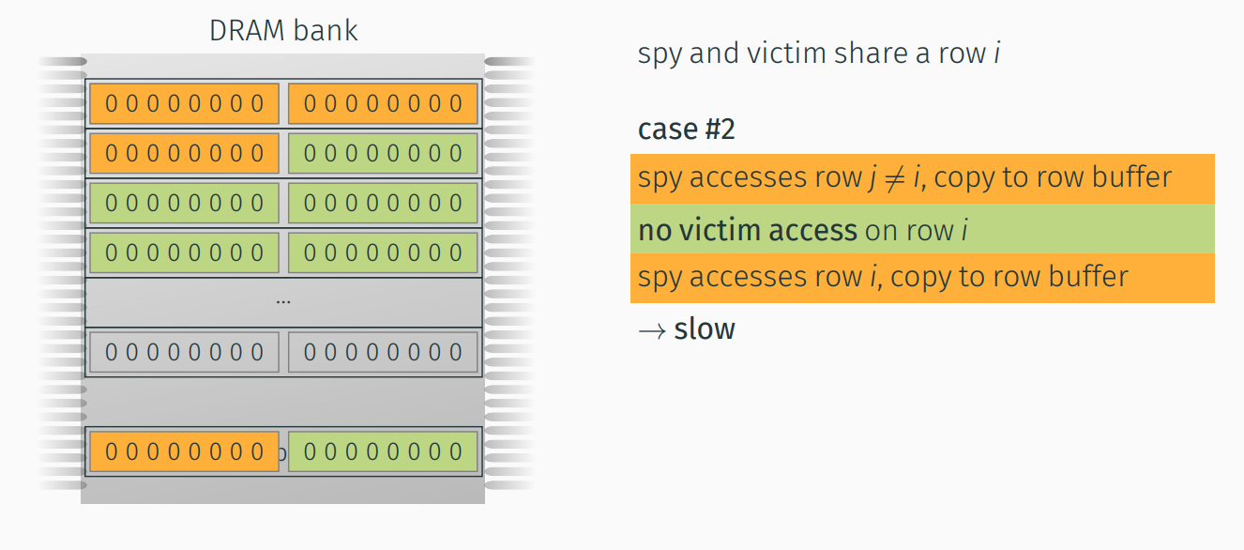
Side-Channel Attack [USENIX sec. ‘16]

Slide 25
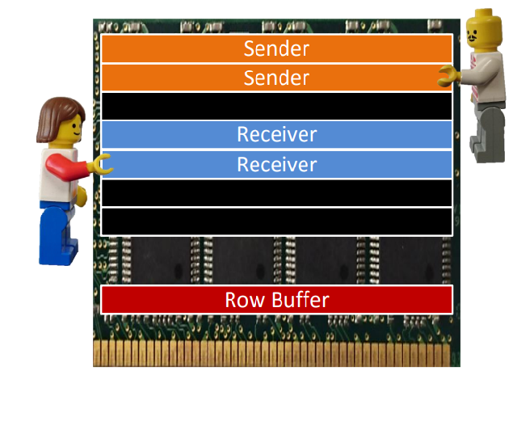
Covert Channel
Covert-channel attacks

Slide 26
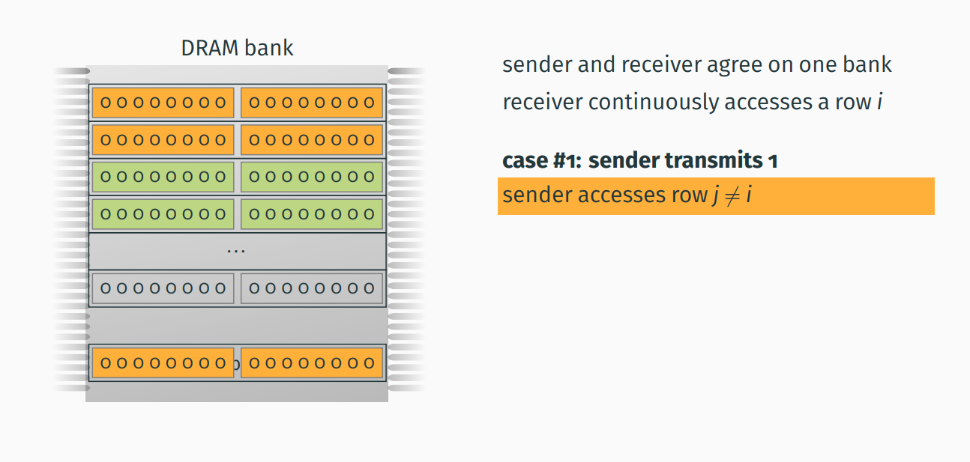
Covert-Channel Attack [USENIX sec. ‘16]

Slide 27
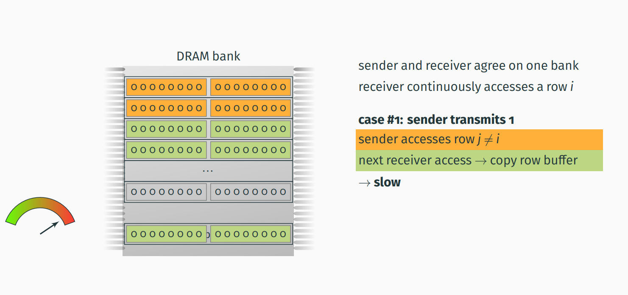
Covert-Channel Attack [USENIX sec. ‘16]

Slide 28
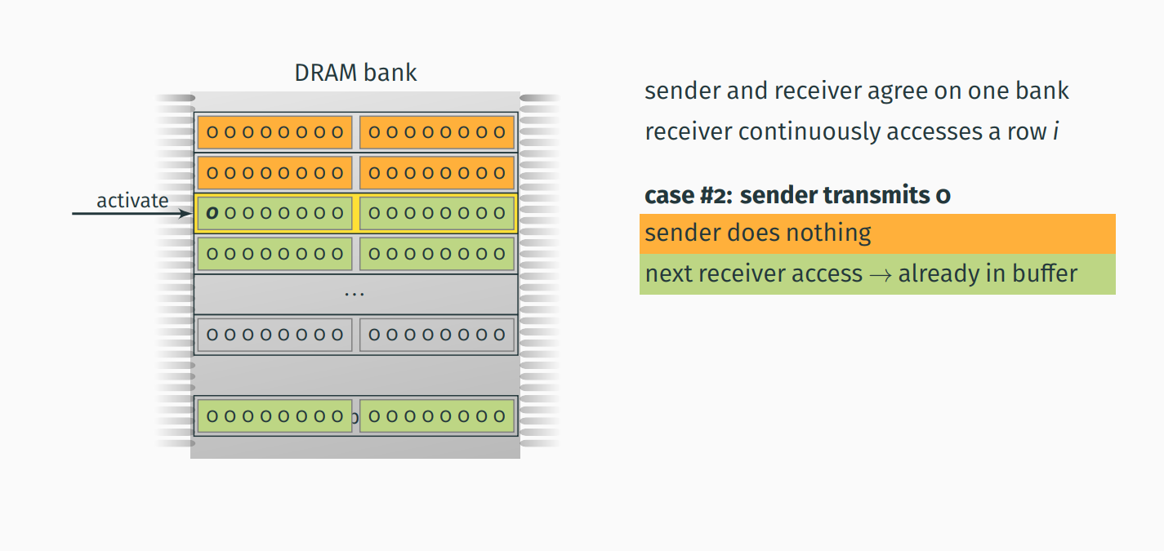
Covert-Channel Attack [USENIX sec. ‘16]

Slide 29
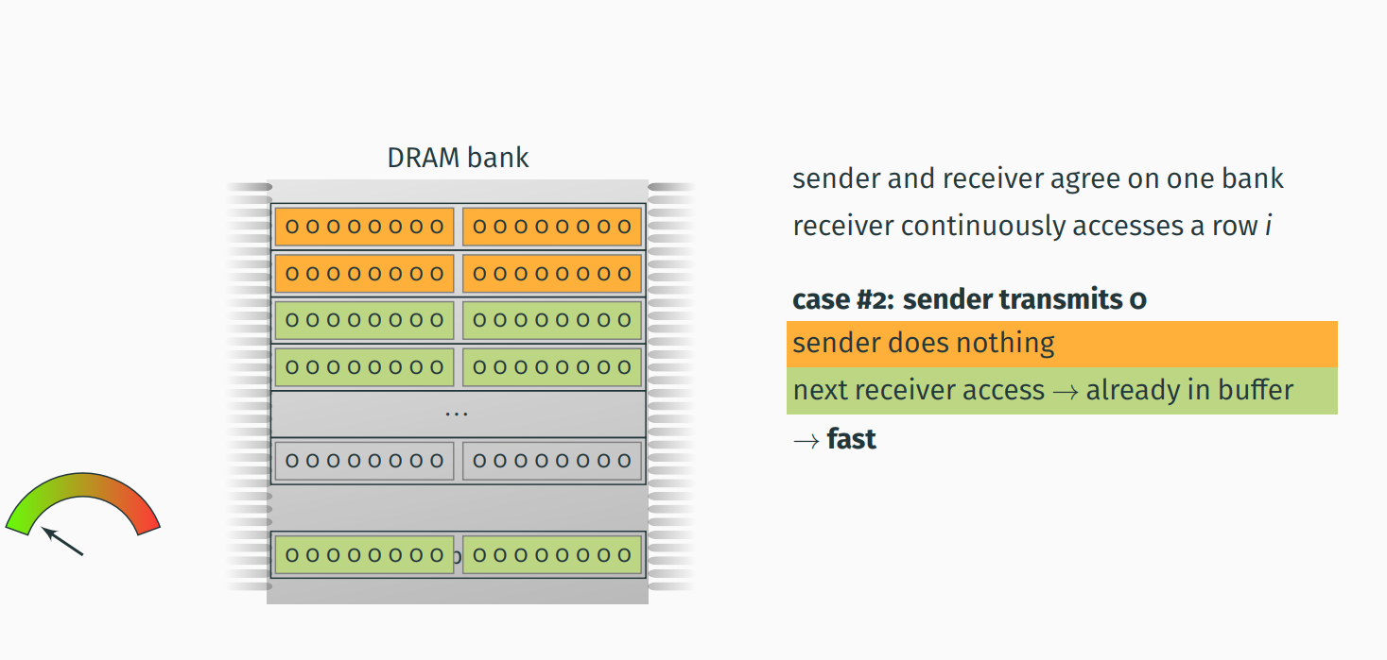
Covert-Channel Attack [USENIX sec. ‘16]

